Slide 1

Integration of I 4.0 standards
Alina Arunova, Maxim Maltsev, Pylyp Matyash, Sattar Rahimbeyli
Tutor: Irlán Grangel

Slide 2
Outline
Motivation
Definition of problem
Goals
Requirements
Architecture
Implementation
Results
Future work
2

Slide 3


Industry 4.0
I 4.0 or Industry 4.0 is a combination of production methods with state-of-the-art information and communication technology. In the world of Industry 4.0, people, machines, equipment, logistics systems and products communicate and cooperate with each other directly.
<CAEXFile FileName="..." SchemaVersion="..." xmlns:xsi="..." xsi:noNamespaceSchemaLocation="...">
<InterfaceClassLib Name="MyInterfaces">
<Version>1.0</Version>
<InterfaceClass Name="Energy" RefBaseClassPath="BaseInterfaceClassLib@AutomationML…"/>
<InterfaceClass Name="Heating" RefBaseClassPath="BaseInterfaceClassLib@AutomationML…"/>
</InterfaceClassLib>
</CAEXFile>
<UANodeSet xmlns:xsi="..." xmlns:xsd="..." xmlns="...">
<UAObject NodeId="ns=2;i=1" BrowseName="ManufacturingSystem">
<DisplayName>ManufacturingSystem</DisplayName>
<Description></Description>
<References>
<Reference ReferenceType="HasTypeDefinition">i=61</Reference>
<Reference ReferenceType="HasComponent">ns=2;i=8</Reference>
</References>
</UAObject>
</UANodeSet>
3

Slide 4

Problems
Globalization forces large companies to go international;
Multinational companies tend to consolidate the standards;
Different industrial standards need to be matched;
Lots of time wasted onto manual object notation transcription.
4

Slide 5


Goal
Validation of each document against standard schema;
Matching of each entity of the document to a respectful entity of another document;
Consolidation of the knowledge into the new unified standard.
Integrated file
5

Slide 6
Functional requirements
High Priority:
Provide automatic document validation
Visualizing input (tree mode)
Direct topology mapping
Producing integration file
Low Priority:
Demo testing of the output against Gold Standard
SPARQL query for the output file
6

Slide 7
Non-functional requirements
High Priority:
Security and fault tolerance
Low Priority:
Time tolerant processing
Scalability
Semantic fuzzy matching
User-friendly interface
7

Slide 8
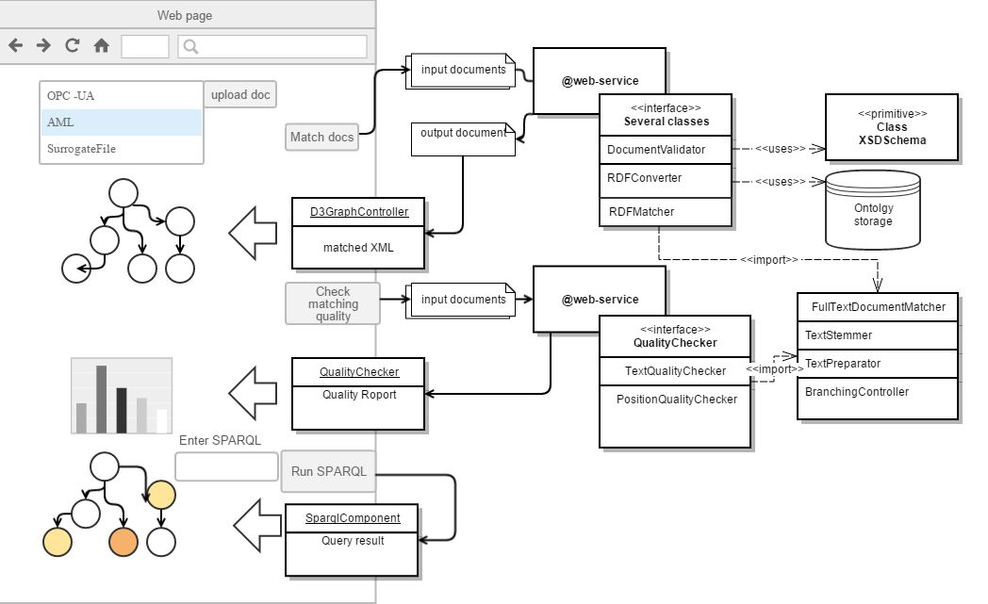
Architecture
8

Slide 9
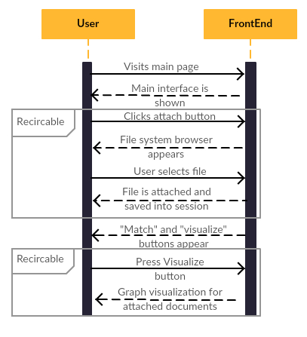
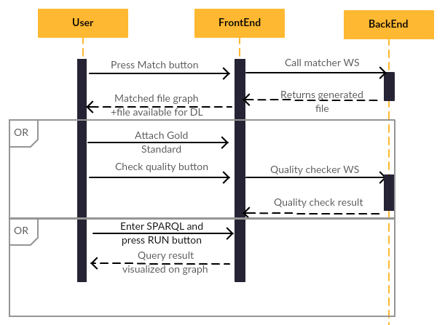
Workflow
9

Slide 10




Responsibilities
Alina
Phil
Maxim
Sattar
Converting AML and OPC UA to RDF
Matching of 2 files
Database and WebController development
Documentation | Deployment
Final presentation
Front end tool for uploading, downloading and extracting the data
Documentation
Tree visualization of the data | Design development
Gold Standard | Testing
10

Slide 11






Tools
11

Slide 12
Challenges
Frontend
Browser session file storage
Flexible tree-view visualization
Backend
OPCUA XSLT transformation
12

Slide 13


Results
Choosing a file:
browse a file from your computer
Visualize tree-view
Download the file
13

Slide 14
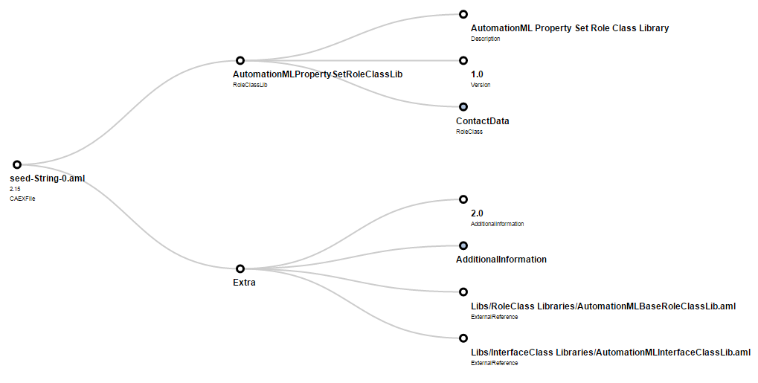
Results
Visualization:
Tree view
14

Slide 15
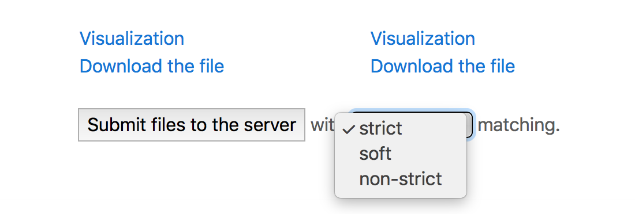
Results
Matching:
Strict (match by statement);
Soft (match by predicate with the common subject);
Non-strict (match by subject).
15

Slide 16
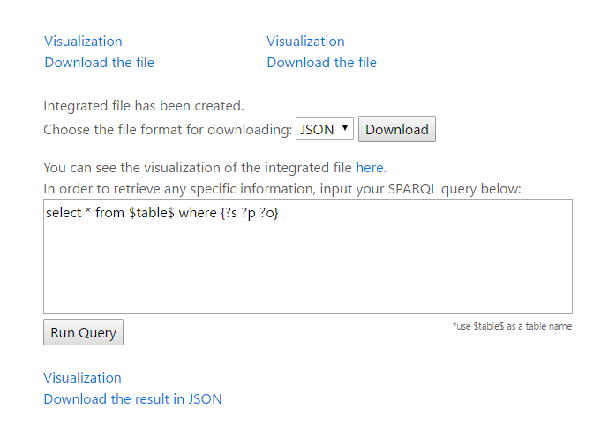
Results
SPARQL query
Download result file
Visualize result file
Golden Standard:
Matching quality
16

Slide 17
Results: Strict matching example
<CAEXFile FileName="..." SchemaVersion="..." xmlns:xsi="..." xsi:noNamespaceSchemaLocation="...">
<InterfaceClassLib Name="MyInterfaces">
<Version>1.0</Version>
<InterfaceClass Name="Energy" RefBaseClassPath="BaseInterfaceClassLib@AutomationML…"/>
<InterfaceClass Name="Heating" RefBaseClassPath="BaseInterfaceClassLib@AutomationML…"/>
</InterfaceClassLib>
</CAEXFile>
<CAEXFile FileName="..." SchemaVersion="..." xmlns:xsi="..." xsi:noNamespaceSchemaLocation="...">
<InterfaceClassLib Name="MyInterfaces">
<Version>1.0</Version>
<InterfaceClass Name="Energy" RefBaseClassPath="BaseInterfaceClassLib@AutomationML…"/>
<InterfaceClass Name=”Water" RefBaseClassPath="BaseInterfaceClassLib@AutomationML…"/>
</InterfaceClassLib>
</CAEXFile>
17

Slide 18
Results: Strict matching example
<https://w3id.org/i40/aml/InterfaceClass2>
a <https://w3id.org/i40/instance/InterfaceClass> ;
<https://w3id.org/i40/instance/refBaseClassPath>
"BaseInterfaceClassLib@AutomationMLInterfaceClassLib/AutomationMLBaseInterface" .
<https://w3id.org/i40/aml/CAEXFile1>
a <https://w3id.org/i40/instance/CAEXFile> ;
<https://w3id.org/i40/instance/hasFileName>
"Topology.aml" ;
<https://w3id.org/i40/instance/hasInterfaceClassLib>
<https://w3id.org/i40/aml/InterfaceClassLib1> ;
<https://w3id.org/i40/instance/hasSchemaVersion>
"2.15" .
<https://w3id.org/i40/aml/InterfaceClass1>
a <https://w3id.org/i40/instance/InterfaceClass> ;
<https://w3id.org/i40/instance/hasAttributeName>
"Energy" ;
<https://w3id.org/i40/instance/refBaseClassPath>
"BaseInterfaceClassLib@AutomationMLInterfaceClassLib/AutomationMLBaseInterface" .
<https://w3id.org/i40/aml/InterfaceClassLib1>
a <https://w3id.org/i40/instance/InterfaceClassLib> ;
<https://w3id.org/i40/instance/hasAttributeName>
"MyInterfaces" ;
<https://w3id.org/i40/instance/hasInterfaceClass>
<https://w3id.org/i40/aml/InterfaceClass1> , <https://w3id.org/i40/aml/InterfaceClass2> .
18

Slide 19

Future work
OPC UA and AML integration
Fuzzy matching
Developing ontology based mapping
19

Slide 20
Thank you for attention!
20

